Slide 1
Microsoft Teams – Create interactive meeting apps for Microsoft Teams

Slide 2
Microsoft Teams meeting apps
Meeting lifecycle
Create meeting apps for Microsoft Teams
Get meeting details in your meeting app

Slide 3
Meeting lifecycle

Slide 4
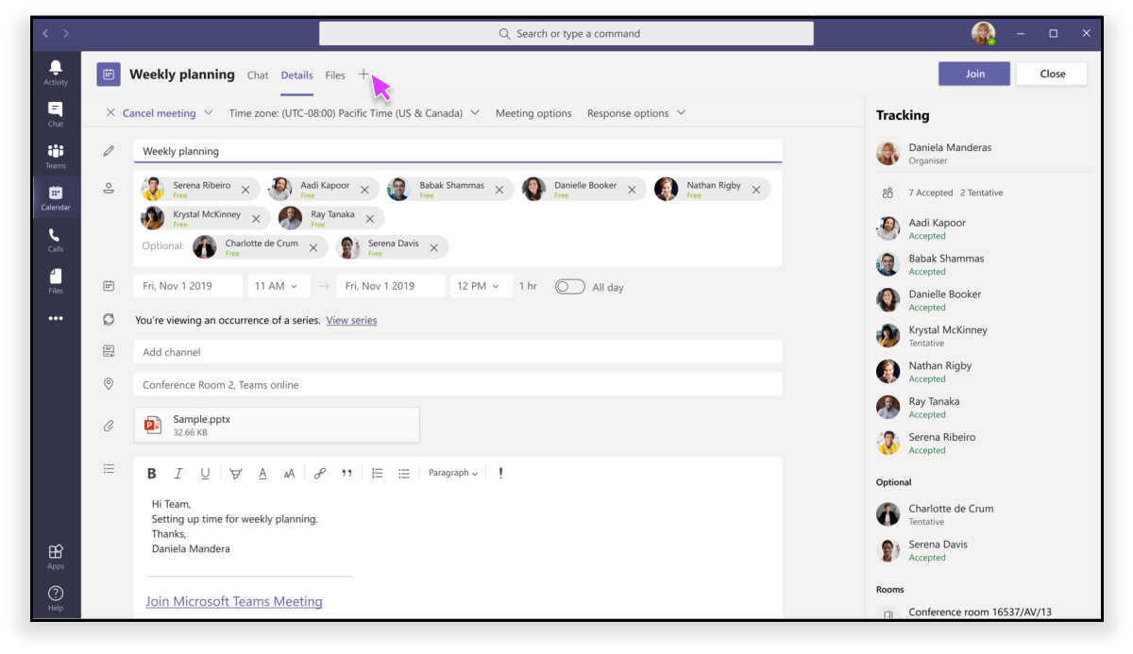
Pre-meeting app experience

Slide 5
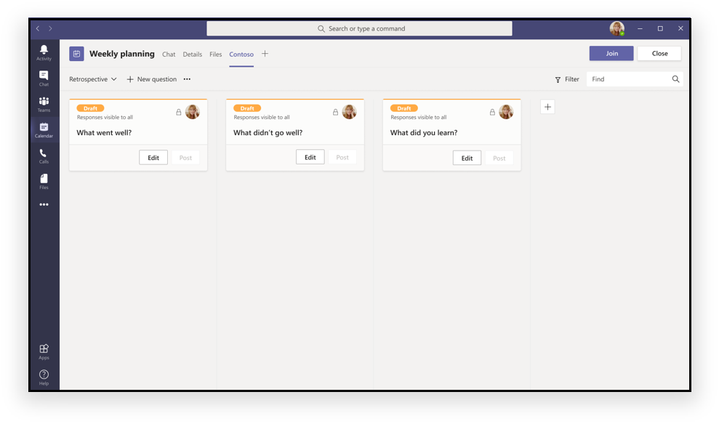
Pre-meeting app experience

Slide 6
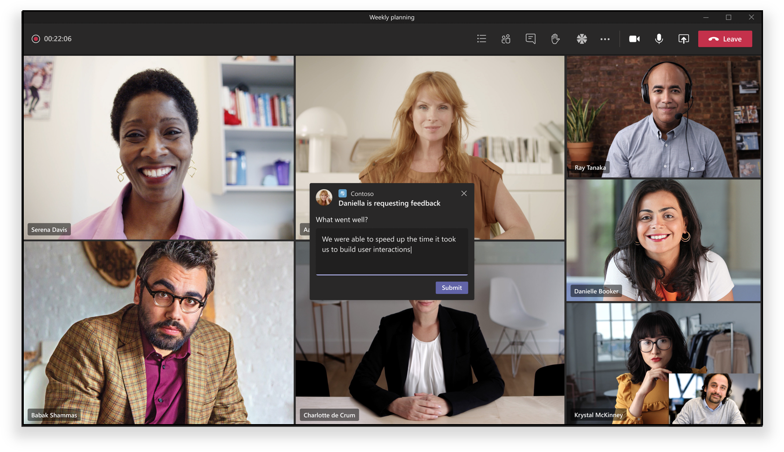
In-meeting app experience

Slide 7
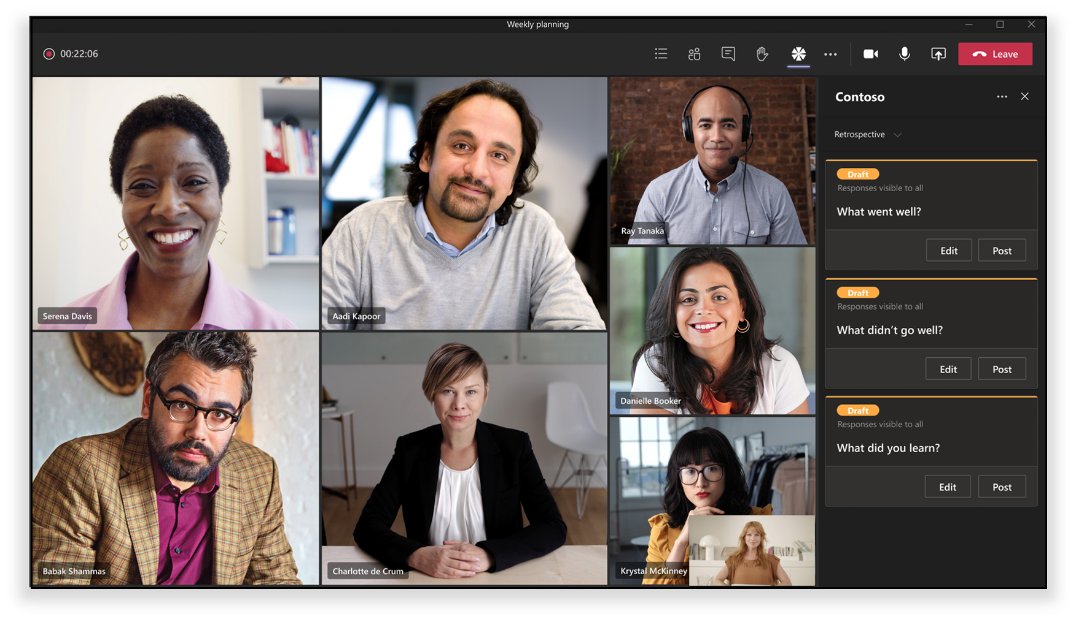
In-meeting app experience

Slide 8
Create meeting apps for Microsoft Teams

Slide 9
Microsoft Teams app manifest
"configurableTabs": [
{
"configurationUrl": "...",
"canUpdateConfiguration": true,
"scopes": [ "groupchat” ],
"context": [
"meetingChatTab", "meetingDetailsTab",
"meetingSidePanel", "meetingStage"
],
"meetingSurfaces": [ "sidePanel", "stage” ]
}
],

Slide 10
Get meeting details in your meeting app
Microsoft Teams meeting apps can utilize support for SSO with tabs
Azure AD apps must be
Multitenant apps
Expose the access_as_user scope
Preauthorize Microsoft Teams clients

Slide 11
Associate the Microsoft Teams app with the Azure AD application
{
...
"webApplicationInfo": {
"id": "023adcaa-4fef-4a4d-a94a-0cde3a0c5b31",
"resource": "api://app.contoso.com/023adcaa-4fef-4a4d-a94a-0cde3a0c5b31"
}
}

Slide 12
Implement the code in the tab or bot to obtain access tokens
Use the access token to identify the user
Use the access token in your own API
Use the access token to access Microsoft Graph

Slide 13
Get meeting details from Microsoft Graph
HTTP GET https://graph.microsoft.com/beta/chats/{chatID}
Requires permission Chat.Read
HTTP GET https://graph.microsoft.com/v1.0/me/onlineMeetings? $filter=JoinWebUrl eq '{chat.onlineMeetingInfo.joinWebUrl}’
Requires permission OnlineMeetings.Read

Slide 14
DEMO
In-meeting experience & participant roles

Slide 15
Determine current meeting lifecycle
Determine current meeting context
Determine current meeting attendee role

Slide 16
Determine current meeting lifecycle

Slide 17
Determine current meeting lifecycle
Developers can conditionally show different content in custom meeting apps based on the current lifecycle of the meeting.
Lifecycle options:
Pre-meeting
In-meeting
Post-meeting

Slide 18
Determine current meeting lifecycle
const startTime = new Date(onlineMeeting.startDateTime as string);
const mainContentElement = (startTime.getTime() < Date.now()) ? getPreMeetingUX() : getPostMeetingUX();
return (
<Provider theme={theme}>
<RTProvider themeName={themeName} lang="en-US">
{mainContentElement}
</RTProvider>
</Provider>
);

Slide 19
Determine current meeting context

Slide 20
Determine current meeting context
Developers can conditionally show different content in custom meeting apps based on the current context where the tab is loaded.
Context options:
content
sidePanel
stage

Slide 21
Determine current meeting context
import { useState, useEffect } from "react";
import { useTeams } from "msteams-react-base-component";
import * as microsoftTeams from "@microsoft/teams-js";
const [{ inTeams, context }] = useTeams();
const [meetingId, setMeetingId] = useState<string | undefined>();
const [frameContext, setFrameContext] = useState<microsoftTeams.FrameContexts | null>();
useEffect(() => {
if (context) {
setMeetingId(context.meetingId);
setFrameContext(context.frameContext);
}
}, [context]);

Slide 22
Determine current meeting context
switch (frameContext) {
case microsoftTeams.FrameContexts.content:
mainContentElement = getPreMeetingUX();
break;
case microsoftTeams.FrameContexts.sidePanel:
mainContentElement = getSidepanelUX();
break;
case microsoftTeams.FrameContexts.meetingStage:
mainContentElement = getMeetingStageUX();
break;
default:
mainContentElement = null;
}
return (
<Provider theme={theme}><RTProvider themeName={themeName} lang="en-US">{mainContentElement}</RTProvider></Provider>
);

Slide 23
Determine current meeting attendee role

Slide 24
Determine current meeting attendee role
Developers can conditionally show different content in custom meeting apps based on the role of the current user.
Role options:
organizer
presenter
attendee

Slide 25
Determine current meeting context
const [onlineMeeting, setOnlineMeeting] = useState<OnlineMeeting>({});
const [userId, userId] = useState<string>("");
const [isOrganizer, setIsOrganizer] = useState<boolean>(false);
useEffect(() => {
if (onlineMeeting && userId && onlineMeeting?.participants?.organizer?.identity?.user?.id === userId) {
setIsOrganizer(true);
} else {
setIsOrganizer(false);
}
}, [userId, onlineMeeting]);

Slide 26
DEMO
In-meeting experience & participant roles

Slide 27
Implement a meeting stage
Meeting events

Slide 28
Implement meeting stage

Slide 29
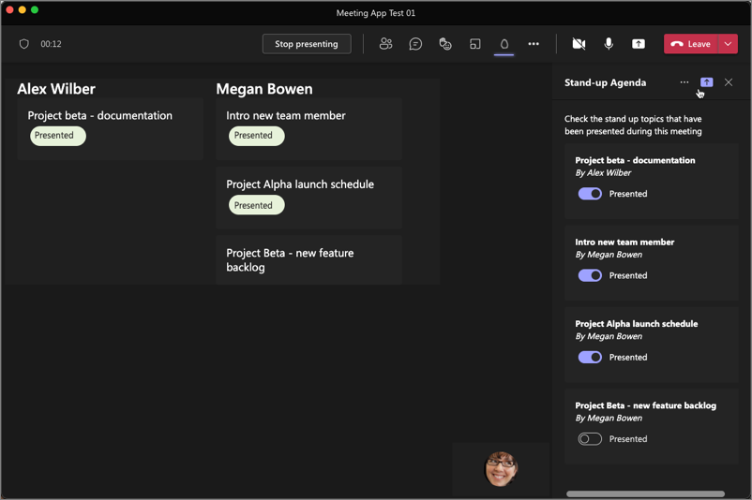
Implement a meeting stage

Slide 30
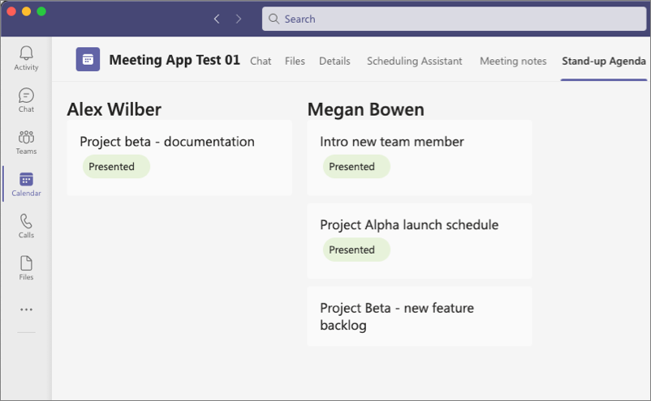
Implement a post-meeting experience

Slide 31
Implement meeting stage & post-meeting
switch (frameContext) {
case microsoftTeams.FrameContexts.content:
if (startDateTime) { mainContentElement = (startDateTime.getTime() < Date.now()) ? getPreMeetingUX() : getMeetingStageUX(); }
break;
case microsoftTeams.FrameContexts.sidePanel:
mainContentElement = getSidepanelUX();
break;
case microsoftTeams.FrameContexts.meetingStage:
mainContentElement = getMeetingStageUX();
break;
default:
mainContentElement = null;
}
return (
<Provider theme={theme}><RTProvider themeName={themeName} lang="en-US">{mainContentElement}</RTProvider></Provider>
);

Slide 32
Meeting events

Slide 33
Meeting events
Create bots & install into meetings
Bots receive real-time events from the meeting
Meeting start
Meeting end

Slide 34
Meeting events & bots
class BotActivityHandler extends TeamsActivityHandler {
constructor(conversationState) {
super();
}
async onTurnActivity(context) {
if (context.activity.type == 'event' && context.activity.name == "application/vnd.microsoft.meetingStart") {
await context.sendActivity("Meeting started.");
}
if (context.activity.type == 'event' && context.activity.name == "application/vnd.microsoft.meetingEnd") {
await context.sendActivity("Meeting ended.");
}
};
}
module.exports.BotActivityHandler = BotActivityHandler;

Slide 35
DEMO
Implement a post-meeting experience for attendees

